Slide 1



AGE 214: Lecture 8
Bipolar Junction Transistor (BJT)
Sokoine University of Agriculture
AGE 214 - Lecture 8

Slide 2


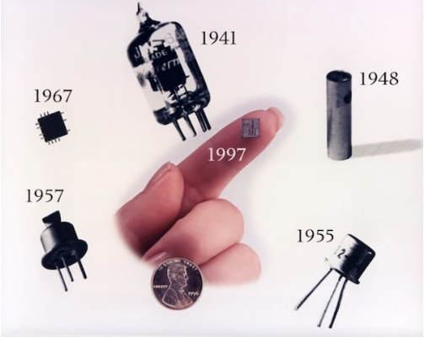
What is a BJT?
Definition
The Transistor (Transfer Resistor) is a three-terminal semiconductor device.
It is the fundamental building block of modern electronics, evolving from the bulky point-contact transistor to microscopic sizes today.
Main Functions
•
Amplification: Boosting a weak signal.
•
Switching: Turning current ON/OFF electronically (Digital Logic).
Sokoine University of Agriculture
AGE 214 - Lecture 8

Slide 3

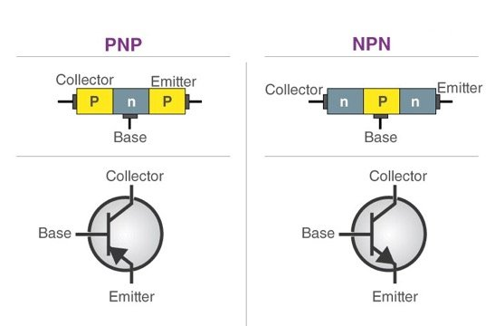
Construction Types
Two Types
•
NPN: P-type material sandwiched between two N-type materials. (Most Common).
•
PNP: N-type material sandwiched between two P-type materials.
It has two PN junctions: Base-Emitter and Base-Collector.
Sokoine University of Agriculture
AGE 214 - Lecture 8

Slide 4






The Three Terminals
Emitter (E)
Base (B)
Collector (C)
Heavily doped. Its job is to Emit carriers (electrons in NPN) into the base.
Very thin and lightly doped. It passes most carriers to the collector but controls the flow.
Moderately doped. Its job is to Collect the carriers coming from the Emitter.
Sokoine University of Agriculture
AGE 214 - Lecture 8

Slide 5
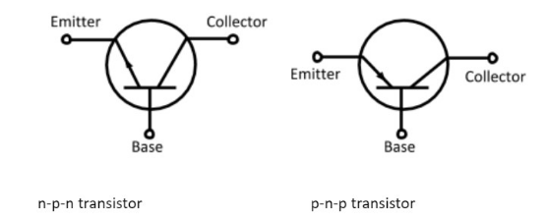
Circuit Symbols
Identifying the Arrow
The arrow is always on the Emitter leg.
•
NPN: Arrow points OUT (Not Pointing iN).
•
PNP: Arrow points IN (Pointing iN - Please).
The arrow indicates the direction of conventional hole current.
Sokoine University of Agriculture
AGE 214 - Lecture 8

Slide 6
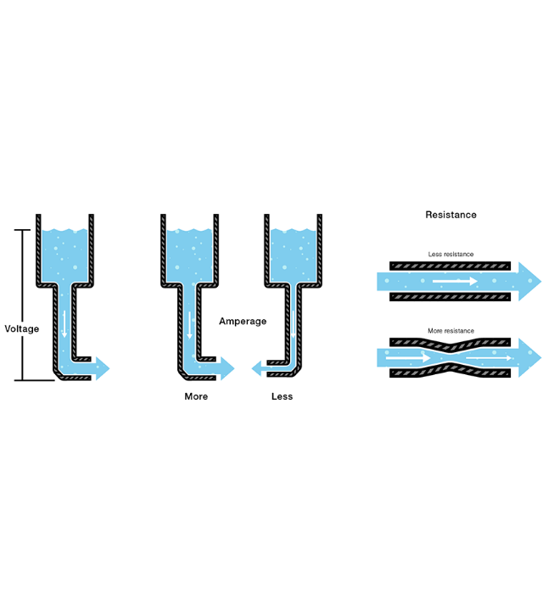
Current Control
Think of the BJT as a Water Valve.
•
Collector-Emitter: The main pipe where large water flows.
•
Base: The valve handle.
•
A small effort (current) at the handle (Base) controls a massive flow of water (current) in the pipe.
•
This illustrates the concept of Amplification.

Slide 7
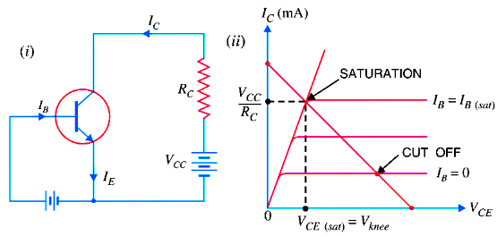
Biasing the Transistor
Operation Conditions
To use the transistor as an amplifier (Active Region):
1.
Base-Emitter (BE) Junction: Must be Forward Biased. (Allows electrons to enter Base).
2.
Collector-Base (CB) Junction: Must be Reverse Biased. (Attracts electrons across to Collector).
Sokoine University of Agriculture
AGE 214 - Lecture 8

Slide 8



Transistor Currents
Kirchhoff's Current Law
By applying KCL to the transistor as a single node:
IE
IC
IB
Emitter Current (Largest)
Collector Current (Almost equal to IE)
Base Current (Very Small, ~1-2%)
Sokoine University of Agriculture
AGE 214 - Lecture 8

Slide 9

DC Current Gain: Alpha (α)
Common Base Gain
Defined as the ratio of Collector Current to Emitter Current.
•
Since I_{C} < I_{E} (due to small loss in Base), ⍺ is always less than 1.
•
Typical values: 0.95 to 0.998.
•
It indicates how efficiently carriers reach the collector.
Sokoine University of Agriculture
AGE 214 - Lecture 8

Slide 10
DC Current Gain: Beta (β)
Common Emitter Gain
Defined as the ratio of Collector Current to Base Current. Also called h_{FE}.
•
This is the amplification factor.
•
Typical values: 50 to 300.
•
Small change in I_{B} causes massive change in I_{C}.
Sokoine University of Agriculture
AGE 214 - Lecture 8

Slide 11




Relationship: α and β
Formulas
Implication
As ⍺ gets closer to 1 (more efficient), β shoots up drastically.
Example: If ⍺ = 0.99, then β = 99.
Sokoine University of Agriculture
AGE 214 - Lecture 8

Slide 12
Questions?
Next Lecture: BJT Configurations (CE, CB, CC)
Dr. Kadeghe Fue
Sokoine University of Agriculture
AGE 214 - Lecture 8

